Slide 1
Efficient way of Data Masking in SQL Server
Unmon Mukherjee
Sr. Software Engineer

Slide 2
Introduction
Almost all column encryption mechanism in SQL Server which are used in production line are SMK (Service Master Key) dependent. This results in high maintenance and real time challenges faced during Server Migration and maintenance. Such encryption mechanism is also tightly coupled to the Certificate or Key used for encryption or decryption. And hence changing the Certificate or Key requires a lot of re-work which is sometimes inconvenient if the size of data is high. Such challenges can be overcome by following some of the Basic Design Principles in SQL Server along with the most basic encryption mechanism. This will also be as secured as the other encryption mechanisms.

Slide 3
Data Masking in SQL Server
Data Masking is a technique to hide critical data like “Passwords”, “Credit Card Numbers” etc. from certain level of users.
There are mainly two types of Encryption mechanism available in an OLTP like SQL Server:
Database level encryption
Column Level encryption
We are going to show how efficiently the Column Level encryption can be implemented by following Design Principles of SQL Server to overcome challenges like:
Server Migration
Slower Development and High Maintenance
More Cost Involved
Service Master Key (SMK) Dependency

Slide 4
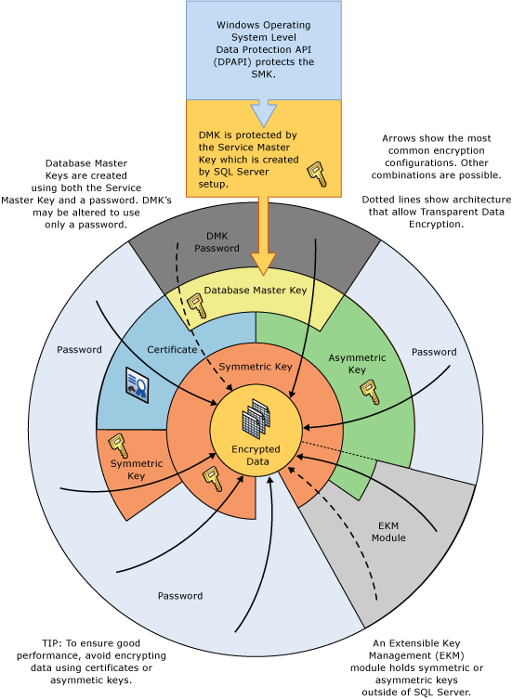
Database Encryption in SQL Server

Slide 5
Column Level encryption in SQL Server
Passphrase
Asymmetric Key
Symmetric Key
Certificate
Passphrase
In this type of encryption mechanism a Phrase is used to encrypt a column value (Password). The same Phrase is used both for Encryption and Decryption.
This simple encryption mechanism if used wisely, could provide a better column level encryption overcoming the challenges which other encryption mechanisms may have.
The following slide will describe the challenges faced while using Encryption mechanism that depends on SMK. Symmetric Key, Asymmetric Key and Certificate encryption mechanisms are dependent on SMK

Slide 6
Major Challenges
Server Migration
When a table uses Symmetric, Asymmetric Key or Certificate to encrypt the column data then these objects are depended on the SMK. Every SQL Server instance has a SMK which is unique. So, let’s say, if a database is migrated from Server A to B, the SMK’s will be different and the encryption mechanism of A will not work on B until the SMK of A is restored on B. This may lead to data loss if B already has some encryption mechanism built on it which uses the SMK of B as SMK of A won’t be able to decrypt the encrypted data already present in B
Increased Development Time
During the server migration process, the restoration of SMK in the new server is required, as a result there will be re-work associated to manage the existing encrypted data in the new server.
SMK depended and High Maintainability
The “Key” or “Certificate” should be maintained properly throughout

Slide 7
The Design
We are going to use the ENCRYPTBYPASSPHRASE and DECRYPTBYPASSPHRASE to build an efficient encryption-decryption mechanism following the most basic Design Principles of SQL Server while considering the following factors:
Scalar Valued Functions
Views
Security
Unique Identifier
Password Vaulting and Trigger
The two Scalar Valued Functions namely dbo.fn_Encrypt and dbo.fn_Decrypt uses the SQL Server’s in-built ENCRYPTBYPASSPHRASE and DECRYPTBYPASSPHRASE to encrypt and decrypt the column data
The Views namely dbo.vw_Encrypt and dbo.vw_Decrypt calls the functions and represents the final data. The table with sensitive data will be hidden and can be only accessed through these views
SQL Server’s secured login is used to provide “SELECT” access only to the Views. The “Phrase” here is the Unique Identifier which is generated automatically through an automated script

Slide 8
Password Vaulting is maintained in a table in the following way
ID | PASSKEY | ISVALID | GENDATE
Auto Number | Unique Identifier | 0 or 1 | Today’s Date
The Unique Identifier is generated everyday and is valid for 24 hrs. You cannot generate more than one PASSKEY in a day which is controlled by a Trigger defined on the table.
This PASSKEY is used by the Functions to Encrypt or Decrypt data. If the password vaulting table doesn’t get refreshed every 24 hrs (12:00 am) then the views will display “Password has expired” as output.
The Password Vaulting ensures better security and automatic maintenance of the KEY and also it is SMK independent i.e. No SMK restoration is required during migration.
Thus we have come up with a design which can be efficient for encrypting column data like “Email Address”, “Passwords”, “Credit Card Numbers” etc. using the most basic encryption mechanism. The server migration time and effort thus reduces which also saves budget as this entire setup is just a SQL Script which needs to be maintained in Source Controls like TFS or SVN.

Slide 9
The two Functions can also be used as a Computed column instead of Views to serve the purpose. Please refer to the attached Technical and Implementation Document for details on the entire setup.
We have not tested this mechanism to encrypt very large values, hence there might be a challenge faced while encrypting such values. However it works good for attributes like “Credit Card Numbers” which are 16 to 20 characters long
Questions?

